Slide 1
Story 1: Infrastructure Investment & Jobs Act Funding Allocation
Waheeb Algabri
CUNY MSDS - DATA608 – Septemper 2024

Slide 2
Prompt
Analyze the Biden Administration’s allocation of funds from the Infrastructure Investment and Jobs Act funding by State and Territory to answer the following questions:
Is the allocation equitable based on the population of each of the States and Territories, or is bias apparent?
Does the allocation favor the political interests of the Biden administration?

Slide 3
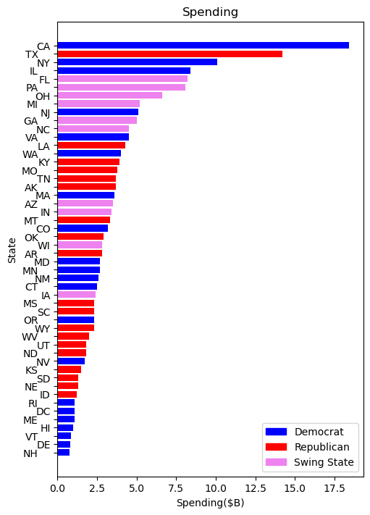
Spending
At first glance, it is clear that spending is not even across states. However, it is not clear that this spending is not equitable or politically motivated.
To determine that, we need more context.
Sources:
1. State Party Designation: Based on 2020 Presidential Election Results. https://electionlab.mit.edu/data
2. Swing State Designation: Based on reporting from Newsweek and AMAC. https://www.newsweek.com/expanding-map-swing-states-that-will-decide-2024-election-1819263 https://amac.us/newsline/elections/swing-states-2024/

Slide 4
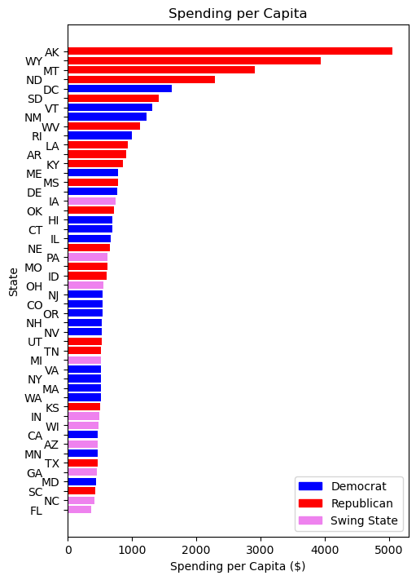
Spending per Capita
If we divide spending per state by the state population, we get spending per capita. This plot indicates that most spending actually went to states aligned with the Biden Administration’s political rivals. However, these states also have low populations, so we should examine further…
Sources:
1. Population data from Census.gov

Slide 5
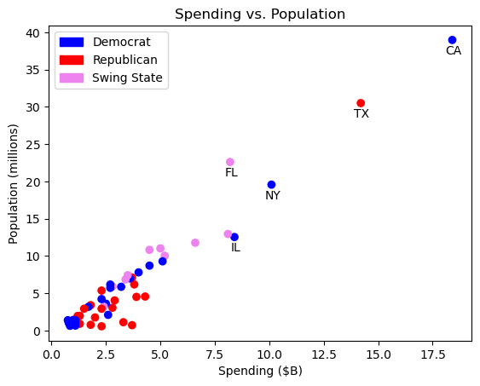
Spending vs Population
We find a clear linear relationship between spending and population. States with larger populations generally received more funding, regardless of party.
We do, however, see some states deviate from this line. What are some other potential drivers of spending?

Slide 6
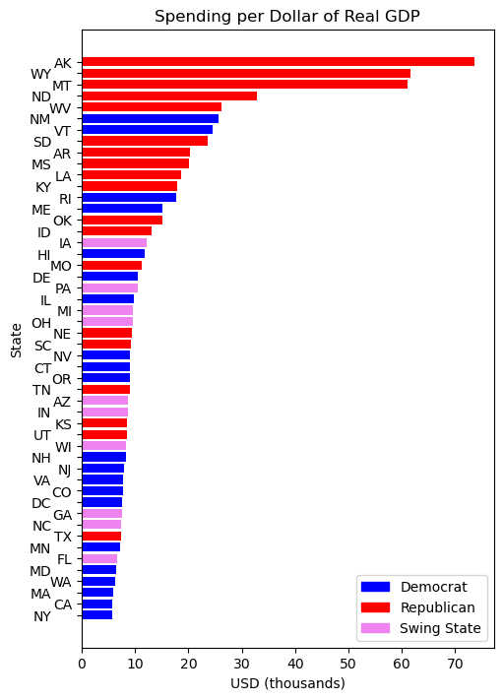
Spending and GDP
If we consider spending as a function of GDP, we find a similar pattern when examining spending per capita. Smaller economies appear to receive an outsized proportion of funding.
Additional Sources:
1. GDP data from the Bureau of Economic Analysis

Slide 7
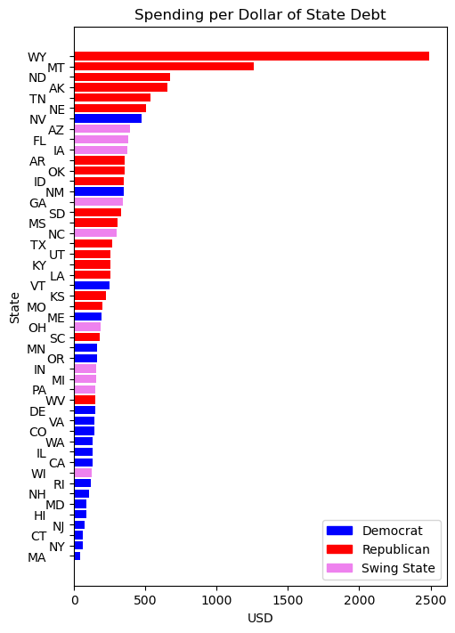
Spending and Debt
With debt, a similar pattern emerges, though with some differences. However, there is no clear evidence of political bias.
Additional Sources:
1. Debt data from Census.gov Annual Survey of State and Local Government Finances
Note that DC is excluded due to lack of data.

Slide 8
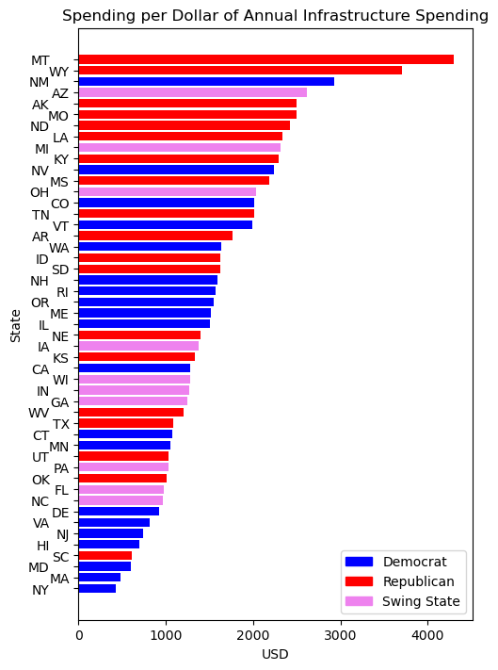
Spending and Infrastructure Spending
If we normalize spending based on 2022 annual state spending on infrastructure, the distribution appears relatively more consistent. That is, perhaps the Administration attempted to divvy funds to states with lots of infrastructure needs.
Additional Sources:
1. Infrastructure spending data from the Census.gov Annual Survey of State and Local Government Finances, calculated as the sum of the following line items: Highways, Air transportation (airports), Parking facilities, Sea and inland port facilities, and Utility expenditure.
Note that DC is excluded due to lack of data.

Slide 9
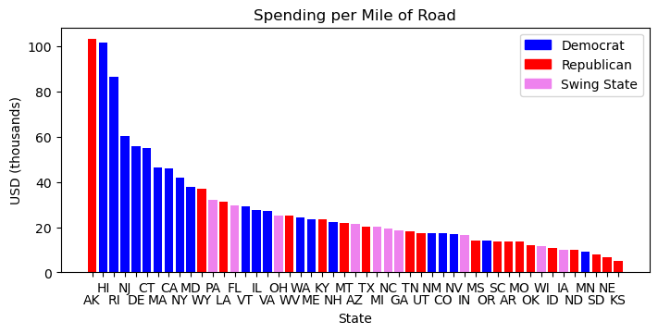
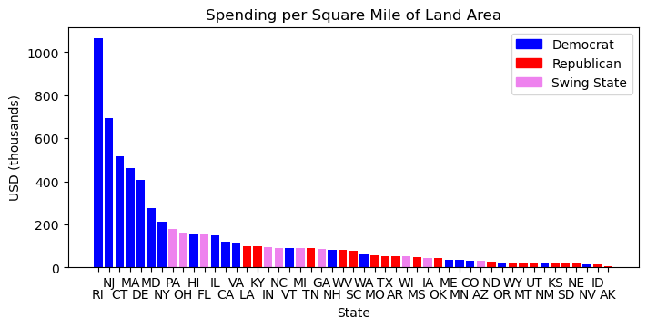
Spending by Road Miles / Land Area
Finally, we can compare spending as a function of geography. In both cases, we see different patterns emerge.
Additional Sources:
1. Road Miles data from the US Department of Transportation https://www.fhwa.dot.gov/policyinformation/statistics/2021/
Note that DC is excluded due to lack of data.
Additional Sources:
Road Miles data from the US Department of Transportation https://www.fhwa.dot.gov/policyinformation/statistics/2021/
Land Area data from the Census.gov State Area Measurements and Internal Point Coordinates
Note that DC is excluded due to lack of data.

Slide 10
Conclusion
In the context of population, GDP and debt, the Administration appears to favor Republican states. In the context of infrastructure, road miles and land area, however, the Administration seems to favor Democratic states.
Overall, it is difficult to claim that the distribution has been entirely equitable, given the skewed distributions we see in all contexts. However, it also difficult to claim that the spending was politically motivated, given the lack of a clear pattern across states with different political leanings.
Ultimately, I find the scatter plot on slide 5 most instructive. It shows that the states with the largest populations received the most funding overall.

